Slide 1
2021 Progress Report: COVID-19’s Impact on People with Disabilities
Ana Torres-Davis
Senior Attorney-Advisor

Slide 2
A Federal Voice for People with Disabilities
Independent Federal Agency
Advisor to the President, Congress & federal agencies
9 Presidential & Congressional appointees, and a professional staff of 12

Slide 3
A Federal Voice for Equitable Healthcare for People with Disabilities
2009: The Current State of Health Care for People with Disabilities
2019: Bioethics Report Series
2021: Accessible Medical Equipment Standards
2021: COVID-19’s Impact on People with Disabilities
2022: Health Equity Framework

Slide 4
Examined COVID-19’s impact on people with disabilities in:
Accessing healthcare
Accessing direct care workers
Congregate care settings and transition
Education
Employment
Effective communication
Mental health and suicide prevention services
Congressional, federal, and state response.

Slide 5
Key Findings: Health Care
High Risk of Triage for people with intellectual or developmental disabilities, and medically fragile and technology dependent individuals, and Crisis Standards of Care (CSC) targeted people with certain disabilities for denial of care.
Failures of healthcare system to follow disability nondiscrimination laws resulted in patients with disabilities being denied critical policy modifications and accommodations.
Physical and programmatic inaccessibility was widespread in many public health responses to the emergency.
The rollout of vaccines left out people with disabilities who were at high-risk from COVID-19, but who did not have health conditions already established as medically high risk.

Slide 6
Key Recommendations: Health Care
Congress or the Department of Health and Human Services (HHS): Require transparency from providers and insurers that receive federal financial assistance
HHS’ Office for Civil Rights (HHS OCR): Patient’s Bill of Rights for People with Disabilities
HHS OCR and DOJ should issue guidance clarifying that covered entities are not excused from their disability nondiscrimination obligations in the event of an epidemic, pandemic, or other public health emergency
HHS/Administration for Community Living (ACL), HHS OCR, and the Department of Justice (DOJ): Establish technical assistance for healthcare providers
Notes:
Key Recommendations
to ensure the United States is prepared for a future pandemic or similar national health crisis, NCD’s key recommendations to policymakers include:

Slide 7
Key Findings: Congregate Care
High number of deaths of people with disabilities in Congregate Care Facilities
A severe shortage of Medicaid Home and Community Based Services (HCBS) kept many in institutionalized settings where the worst death toll took place.
The shortage of direct care workers became worse during the pandemic, further endangering people with disabilities.

Slide 8
Key Recommendations: Congregate Care
Centers for Disease Control and Prevention (CDC) should emphasize CCF census reduction as an infection control strategy
CMS should prioritize all CCFs for infection control purposes and ensure that they receive necessary safety equipment for future health emergencies
CMS should clarify that community providers conducting in-reach transition support should not be restricted from entering facilities during future pandemics or crises
DOJ should issue guidance concerning public entities’ Olmstead obligations and how those entities should take advantage of specific federal resources to facilitate transition and diversion from CCFs, including emergency resources.

Slide 9
Key Findings: Effective Communication
The widespread use of opaque face masks served as a communication barrier
There was a months-long nationwide shortage of PPE, and sign language interpreters in healthcare settings did not have sufficient access
Telemedicine platforms remained inaccessible to people with communications
disabilities
Remote and hybrid learning modalities failed to provide proper communication
accommodations to students with disabilities
Local, state, and federal government entities did not disseminate information related to the COVID-19 pandemic, its transmission, and vaccines in fully accessible formats

Slide 10
Key Recommendations: Effective Communications
HHS OCR and DOJ should direct healthcare providers to include in their nondiscrimination notices recognition of patient rights to policy modifications
All federal entities involved in public health, emergency management, and the provision of public announcements or briefings of broad public importance should prepare and disseminate information related to any pandemic or public health emergency in accessible formats
State Hospital Associations should develop guidance and best practices for ensuring effective communication in hospitals and associated urgent care clinics

Slide 11
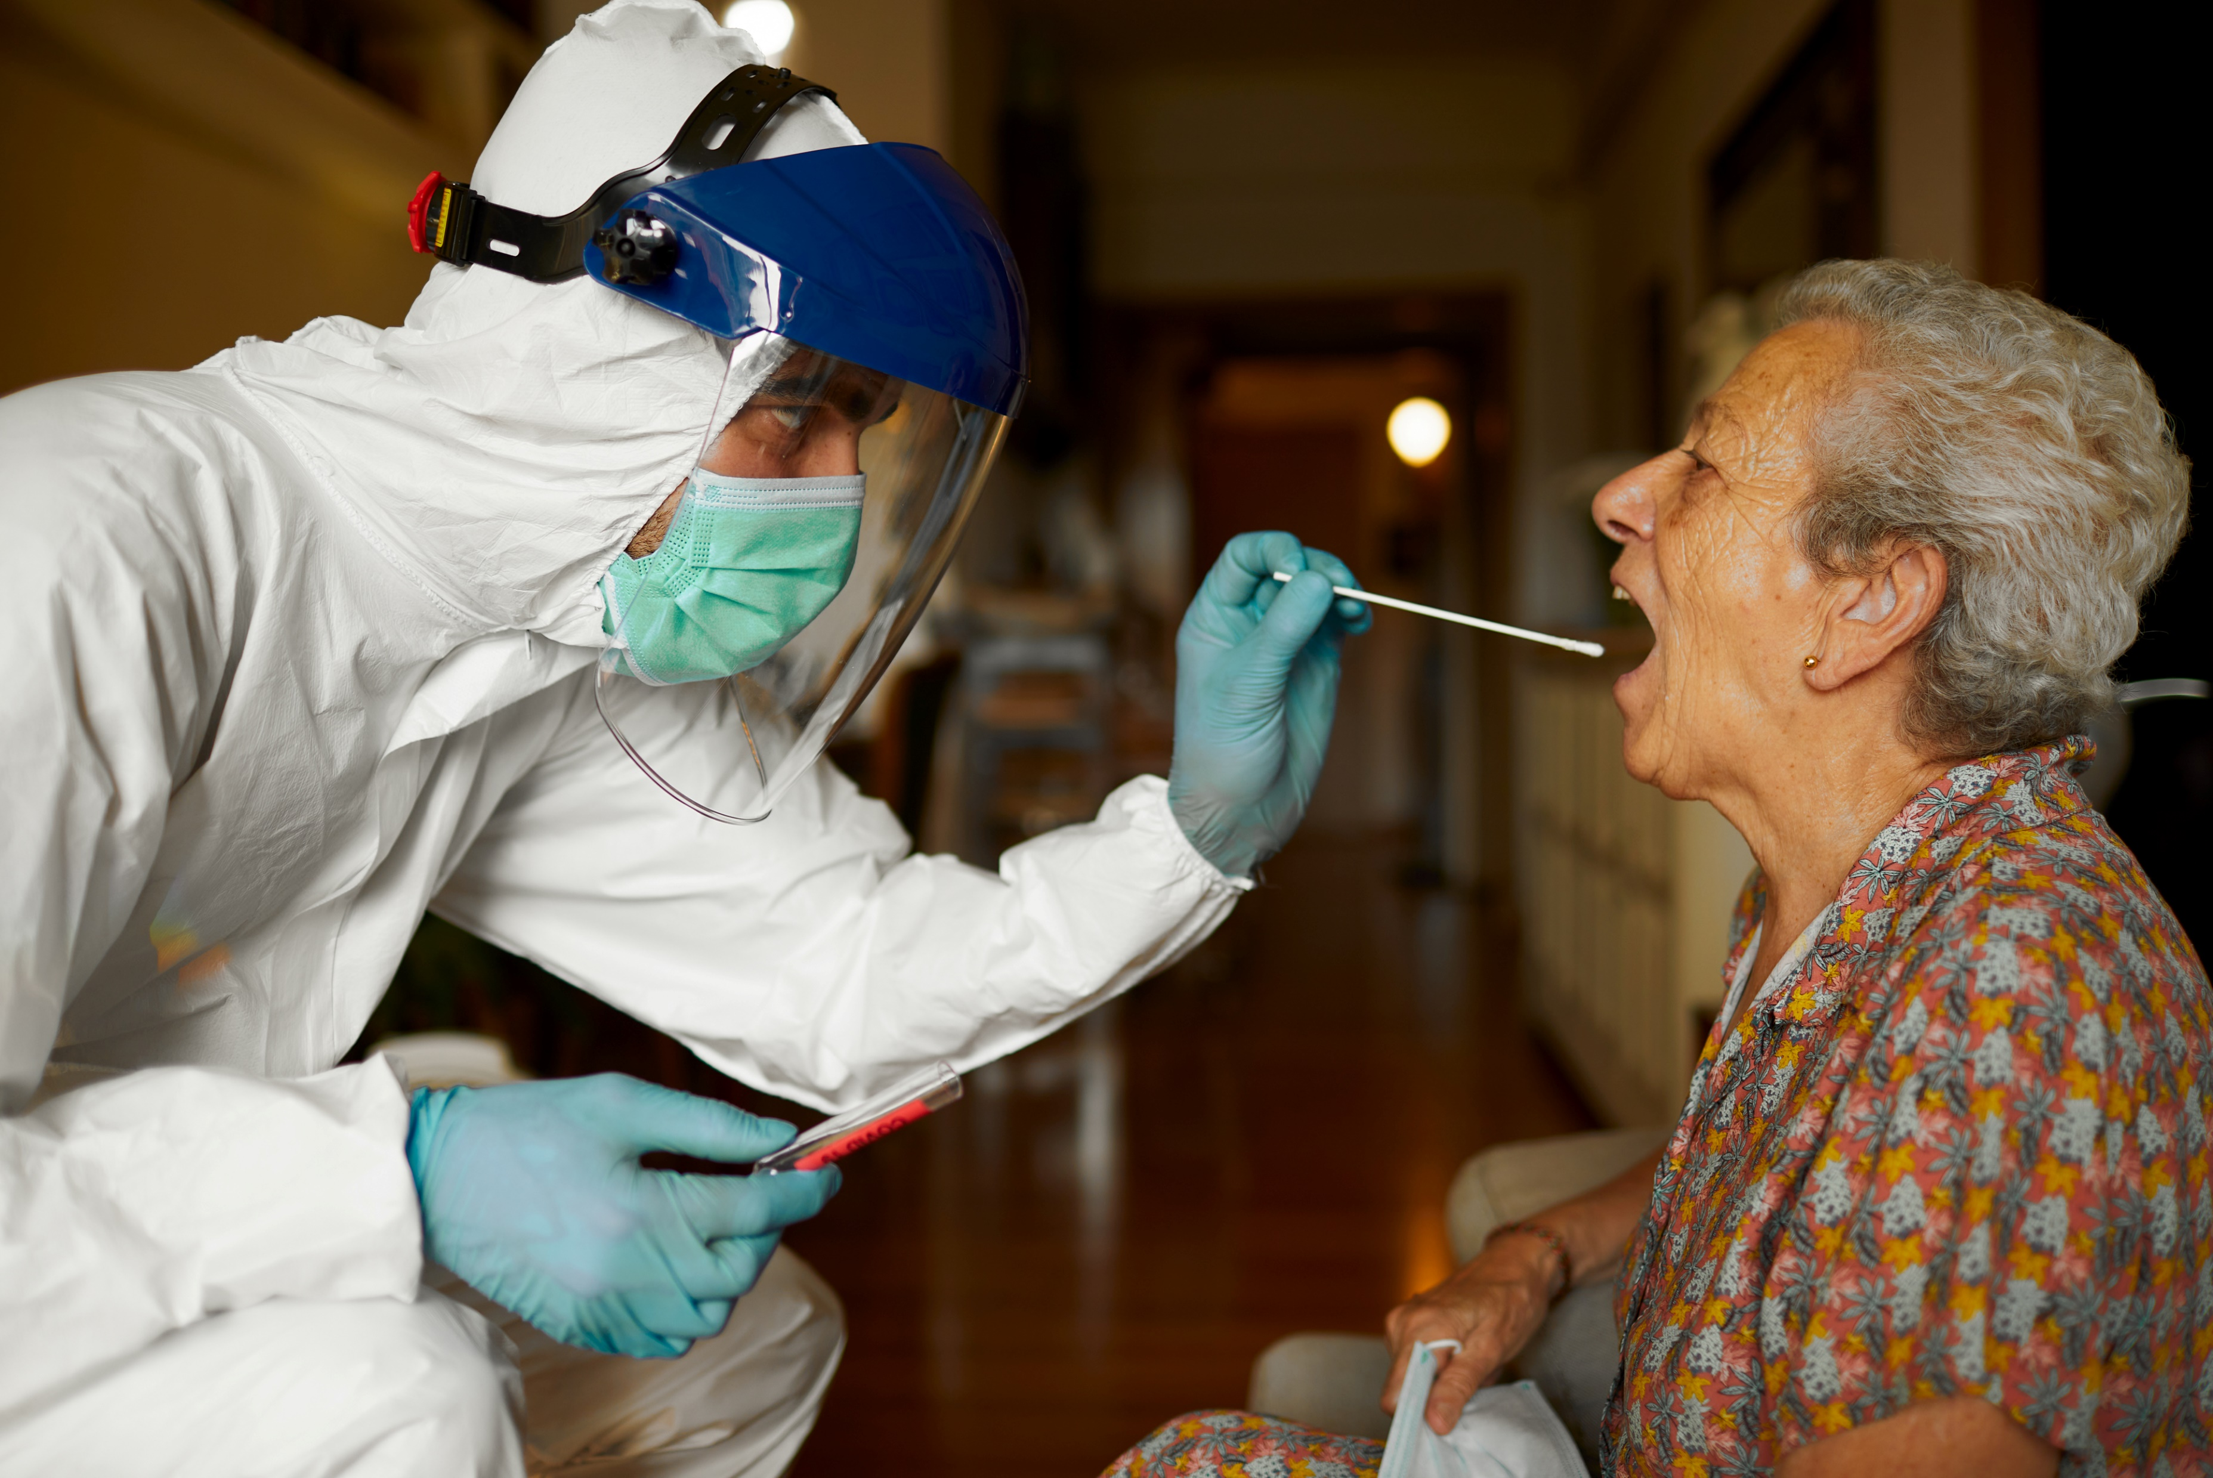

Slide 12
NCD’s Health Equity Framework for Policymakers
March 24, 2022

Slide 13
NCD’s Health Equity Framework
Purpose / The Need
Core Components & Overview
Next Steps
Questions & Feedback

Slide 14
Purpose/ The Need
Address Decades-Long Health Disparities
Address Ableism, Physical and Other Systemic Barriers
Achieve Health Equity for all Categories of Persons with Disabilities

Slide 15
Multi-Disciplinary “Dream Team” Advisors
Lisa Iezzoni, M.D., M.Sc., Prof. of Medicine, Harvard Medical School
Kristi Kirschner, M.D., Clinical Prof., University of Illinois College of Medicine
Margaret A Turk, MD, Prof. Physical Medicine and Rehabilitation, SUNY Upstate University Hospital, Co-Editor-in-Chief, Disability and Health Journal
Priya Chandan, MD, PhD, MPH, Assistant Prof. University of Louisville SOM Division of Physical Medicine & Rehabilitation, Project Director, National Curriculum Initiative in Developmental Medicine
Elizabeth Pendo, JD. Prof. of Law, St. Louis University School of Law
Rosaly Correa-De-Araujo, MD, PhD, Senior Scientific Advisor, National Institute on Aging Division of Geriatrics and Clinical Gerontology
Barbara Kornblau, JD, Program Director and Prof. at the Idaho State University
Bonnielin Swenor, PhD, MPH, Associate Professor of Ophthalmology, Johns Hopkins

Slide 16
Multi-Disciplinary “Dream Team” Advisors
Susan Havercamp, PhD, Associate Professor, Center for Psychiatry and Behavioral Health, College of Medicine, The Ohio State University Nisonger Center
Michael M. McKee, M.D., M.P.H., Associate Prof., Department of Family Medicine, University of Michigan Medical School
JoAnne Theirry, Ph.D., Team Lead, Disability Policy, and Intervention and Programs, Centers for Disease Control and Prevention
Cheri Blauwet, Director, Kelly Adaptive Sports Research Institute, Assistant Professor, Harvard Medical School, Bringham and Women’s Hospital
Deborah Klein Walker, EdD, Adjunct Prof., Community Health Sciences, Boston University School of Public Health
Dr. Rick Rader, NCD Council Member, Director, Habilitation Center, Orange Grove Center; President, American Association on Health and Disability

Slide 17
Core Components & Overview
Four Core Components
Special Medically Underserved Population (SMUP) Designation
Comprehensive Disability Clinical-Care Curricula
Accessible Medical Diagnostic Equipment
Improved Data Capturing
35 Additional Components

Slide 18
Core Component No. 1 - Special MUP Designation
Congress to direct the Health Resource and Services Administration (HRSA) to designate all people with disabilities as a Medically Underserved Population under the Public Health Service Act.
Typically, MUP designations require population groupings based upon geography, which is not an applicable means of providing equitable healthcare to the national community of people with disabilities

Slide 19
Core Component No. 1 - Special MUP Designation
Benefits
Federal Funding for FQHCs and Health Centers
Loan Repayment and HRSA Training Programs
Higher Medicare and Medicaid Reimbursement
Federal Research Preference and Funding
Among many others

Slide 20
MUP Designation Alternative
“Health Disparity Population” designation under Minority Health and Health Disparities Research and Education Act of 2000
“Health Disparity Population” exists if there is a significant disparity in the overall rate of disease incidence, prevalence, morbidity, mortality, or survival rates in the population compared to the health status of the general population

Slide 21
Core Component No. 2 – Comprehensive Disability Clinical-Care Curricula
Sec. 5307 of Patient Protection and Affordable Care Act
Applicable to:
US Undergraduate Medical, Nursing, Healthcare Professional and Allied-Health Programs
Graduate Residency and Fellowship Programs
International Medical Schools

Slide 22
Core Component No. 3 – AMDE
Adoption of US Access Board’s 2017 Voluntary Standards
Department of Justice – Americans with Disabilities Act
HHS Office of Civil Rights – Section 504 of the Rehabilitation Act of 1973

Slide 23
Core Component No. 4 – Improved Data Collection
Public Health Surveillance Systems
Electronic Health Records
National Academy of Sciences Comprehensive Study of HHS’ Data Collection Systems and Practices

Slide 24
NCD’s Health Equity Framework
Questions & Feedback

Slide 25
NCD’s Health Equity Framework for Policymakers
Thank You!
NCD Points of Contact:
Amged Soliman, Senior Attorney Advisor, Asoliman@ncd.gov

